Slide 1
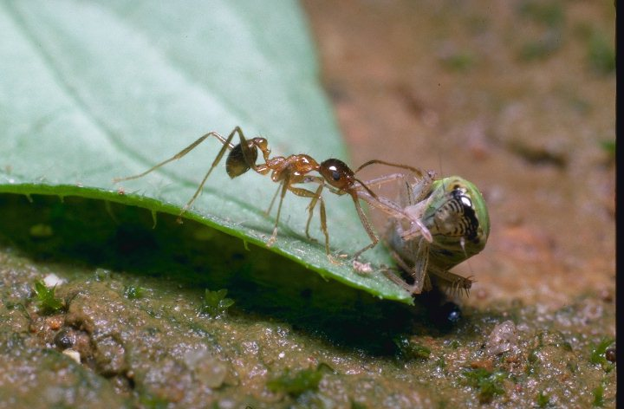
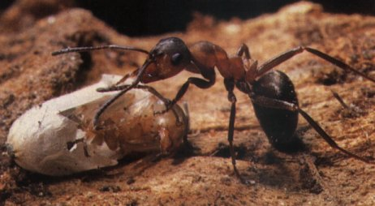
G5BAIM
Artificial Intelligence Methods
Graham Kendall
Simulated Annealing

Slide 2
Simulated Annealing
Motivated by the physical annealing process
Material is heated and slowly cooled into a uniform structure
Simulated annealing mimics this process
The first SA algorithm was developed in 1953 (Metropolis)

Slide 3
Simulated Annealing
Compared to hill climbing the main difference is that SA allows downwards steps
Simulated annealing also differs from hill climbing in that a move is selected at random and then decides whether to accept it
In SA better moves are always accepted. Worse moves are not

Slide 4
Simulated Annealing
Kirkpatrick (1982) applied SA to optimisation problems
  Kirkpatrick, S , Gelatt, C.D., Vecchi, M.P. 1983. Optimization by Simulated Annealing. Science, vol 220, No. 4598, pp 671-680

Slide 5
The Problem with Hill Climbing
Gets stuck at local minima
Possible solutions
  Try several runs, starting at different positions
  Increase the size of the neighbourhood (e.g. in TSP try 3-opt rather than 2-opt)

Slide 6
To accept or not to accept?
The law of thermodynamics states that at temperature, t, the probability of an increase in energy of magnitude, δE, is given by
P(δE) = exp(-δE /kt)
Where k is a constant known as Boltzmann’s constant

Slide 7
To accept or not to accept - SA?
P = exp(-c/t) > r
Where
  c is change in the evaluation function
  t the current temperature
  r is a random number between 0 and 1
Example

Slide 8
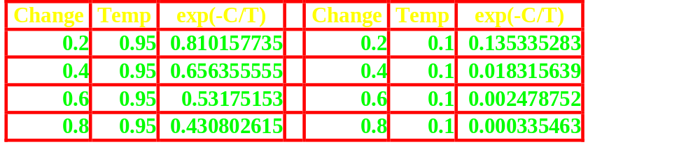
To accept or not to accept - SA?

Slide 9
To accept or not to accept - SA?
The probability of accepting a worse state is a function of both the temperature of the system and the change in the cost function
As the temperature decreases, the probability of accepting worse moves decreases
If t=0, no worse moves are accepted (i.e. hill climbing)

Slide 10
SA Algorithm
The most common way of implementing an SA algorithm is to implement hill climbing with an accept function and modify it for SA
The example shown here is taken from Russell/Norvig (for consistency with the rest of the course)

Slide 11
SA Algorithm
Function SIMULATED-ANNEALING(Problem, Schedule) returns a solution state
Inputs: Problem, a problem
  Schedule, a mapping from time to temperature
  Local Variables : Current, a node
  Next, a node
  T, a “temperature” controlling the probability of downward steps
Current = MAKE-NODE(INITIAL-STATE[Problem])

Slide 12
SA Algorithm
For t = 1 to ∞ do
T = Schedule[t]
If T = 0 then return Current
Next = a randomly selected successor of Current
ΛE = VALUE[Next] – VALUE[Current]
if ΛE > 0 then Current = Next
else Current = Next only with probability exp(-ΛE/T)

Slide 13
SA Algorithm - Observations
The cooling schedule is hidden in this algorithm - but it is important (more later)
The algorithm assumes that annealing will continue until temperature is zero - this is not necessarily the case

Slide 14
SA Cooling Schedule
Starting Temperature
Final Temperature
Temperature Decrement
Iterations at each temperature

Slide 15
SA Cooling Schedule - Starting Temperature
Starting Temperature
  Must be hot enough to allow moves to almost neighbourhood state (else we are in danger of implementing hill climbing)
  Must not be so hot that we conduct a random search for a period of time
  Problem is finding a suitable starting temperature

Slide 16
SA Cooling Schedule - Starting Temperature
Starting Temperature - Choosing
  If we know the maximum change in the cost function we can use this to estimate
  Start high, reduce quickly until about 60% of worse moves are accepted. Use this as the starting temperature
  Heat rapidly until a certain percentage are accepted the start cooling

Slide 17
SA Cooling Schedule - Final Temperature
Final Temperature - Choosing
  It is usual to let the temperature decrease until it reaches zero
  However, this can make the algorithm run for a lot longer, especially when a geometric cooling schedule is being used
  In practise, it is not necessary to let the temperature reach zero because the chances of accepting a worse move are almost the same as the temperature being equal to zero

Slide 18
SA Cooling Schedule - Final Temperature
Final Temperature - Choosing
  Therefore, the stopping criteria can either be a suitably low temperature or when the system is “frozen” at the current temperature (i.e. no better or worse moves are being accepted)

Slide 19
SA Cooling Schedule - Temperature Decrement
Temperature Decrement
  Theory states that we should allow enough iterations at each temperature so that the system stabilises at that temperature
  Unfortunately, theory also states that the number of iterations at each temperature to achieve this might be exponential to the problem size

Slide 20
SA Cooling Schedule - Temperature Decrement
Temperature Decrement
  We need to compromise
  We can either do this by doing a large number of iterations at a few temperatures, a small number of iterations at many temperatures or a balance between the two

Slide 21
SA Cooling Schedule - Temperature Decrement
Temperature Decrement
  Linear
    temp = temp - x
  Geometric
    temp = temp * x
    Experience has shown that α should be between 0.8 and 0.99, with better results being found in the higher end of the range. Of course, the higher the value of α, the longer it will take to decrement the temperature to the stopping criterion

Slide 22
SA Cooling Schedule - Iterations
Iterations at each temperature
  A constant number of iterations at each temperature
  Another method, first suggested by (Lundy, 1986) is to only do one iteration at each temperature, but to decrease the temperature very slowly.

Slide 23
SA Cooling Schedule - Iterations
Iterations at each temperature
  The formula used by Lundy is
    t = t/(1 + βt)
where β is a suitably small value

Slide 24
SA Cooling Schedule - Iterations
Iterations at each temperature
  An alternative is to dynamically change the number of iterations as the algorithm progresses
  At lower temperatures it is important that a large number of iterations are done so that the local optimum can be fully explored
  At higher temperatures, the number of iterations can be less

Slide 25
Problem Specific Decisions
The cooling schedule is all about SA but there are other decisions which we need to make about the problem
These decisions are not just related to SA

Slide 26
Problem Specific Decisions - Cost Function
The evaluation function is calculated at every iteration
Often the cost function is the most expensive part of the algorithm

Slide 27
Problem Specific Decisions - Cost Function
Therefore
  We need to evaluate the cost function as efficiently as possible
  Use Delta Evaluation
  Use Partial Evaluation

Slide 28
Problem Specific Decisions - Cost Function
If possible, the cost function should also be designed so that it can lead the search
  One way of achieving this is to avoid cost functions where many states return the same value
  This can be seen as representing a plateau in the search space which the search has no knowledge about which way it should proceed
  Bin Packing

Slide 29
Problem Specific Decisions - Cost Function
Many cost functions cater for the fact that some solutions are illegal. This is typically achieved using constraints
  Hard Constraints : these constraints cannot be violated in a feasible solution
  Soft Constraints : these constraints should, ideally, not be violated but, if they are, the solution is still feasible

Slide 30
Problem Specific Decisions - Cost Function
Hard constraints are given a large weighting. The solutions which violate those constraints have a high cost function
Soft constraints are weighted depending on their importance
Weightings can be dynamically changed as the algorithm progresses. This allows hard constraints to be accepted at the start of the algorithm but rejected later

Slide 31
Problem Specific Decisions - Neighbourhood
How do you move from one state to another?
When you are in a certain state, what other states are reachable?

Slide 32
Problem Specific Decisions - Neighbourhood
Some results have shown that the neighbourhood structure should be symmetric. That is, if you move from state i to state j then it must be possible to move from state j to state i
However, a weaker condition can hold in order to ensure convergence.
Every state must be reachable from every other. Therefore, it is important, when thinking about your problem to ensure that this condition is met

Slide 33
Problem Specific Decisions - Performance
What is performance?
  Quality of the solution returned
  Time taken by the algorithm
We already have the problem of finding suitable SA parameters (cooling schedule)

Slide 34
Problem Specific Decisions - Performance
Improving Performance - Initialisation
  Start with a random solution and let the annealing process improve on that.
  Might be better to start with a solution that has been heuristically built (e.g. for the TSP problem, start with a greedy search)

Slide 35
Problem Specific Decisions - Performance
Improving Performance - Hybridisation
  or memetic algorithms
  Combine two search algorithms
  Relatively new research area

Slide 36
Problem Specific Decisions - Performance
Improving Performance - Hybridisation
  Often a population based search strategy is used as the primary search mechanism and a local search mechanism is applied to move each individual to a local optimum
  It may be possible to apply some heuristic to a solution in order to improve it

Slide 37
SA Modifications - Acceptance Probability
The probability of accepting a worse move is normally based on the physical analogy (based on the Boltzmann distribution)
But is there any reason why a different function will not perform better for all, or at least certain, problems?

Slide 38
SA Modifications - Acceptance Probability
Why should we use a different acceptance criteria?
  The one proposed does not work. Or we suspect we might be able to produce better solutions
  The exponential calculation is computationally expensive.
  (Johnson, 1991) found that the acceptance calculation took about one third of the computation time

Slide 39
SA Modifications - Acceptance Probability
Johnson experimented with
P(δ) = 1 – δ/t
This approximates the exponential

Slide 40
SA Modifications - Acceptance Probability
A better approach was found by building a look-up table of a set of values over the range δ/t
During the course of the algorithm δ/t was rounded to the nearest integer and this value was used to access the look-up table
This method was found to speed up the algorithm by about a third with no significant effect on solution quality

Slide 41
SA Modifications - Cooling
If you plot a typical cooling schedule you are likely to find that at high temperatures many solutions are accepted
If you start at too high a temperature a random search is emulated and until the temperature cools sufficiently any solution can be reached and could have been used as a starting position

Slide 42
SA Modifications - Cooling
At lower temperatures, a plot of the cooling schedule, is likely to show that very few worse moves are accepted; almost making simulated annealing emulate hill climbing

Slide 43
SA Modifications - Cooling
Taking this one stage further, we can say that simulated annealing does most of its work during the middle stages of the cooling schedule
(Connolly, 1990) suggested annealing at a constant temperature

Slide 44
SA Modifications - Cooling
But what temperature?
It must be high enough to allow movement but not so low that the system is frozen
But, the optimum temperature will vary from one type of problem to another and also from one instance of a problem to another instance of the same problem

Slide 45
SA Modifications - Cooling
One solution to this problem is to spend some time searching for the optimum temperature and than stay at that temperature for the remainder of the algorithm
The final temperature is chosen as the temperature that returns the best cost function during the search phase

Slide 46
SA Modifications - Neighbourhood
The neighbourhood of any move is normally the same throughout the algorithm but…
The neighbourhood could be changed as the algorithm progresses
For example, a cost function based on penalty values can be used to restrict the neighbourhood if the weights associated with the penalties are adjusted as the algorithm progresses

Slide 47
SA Modifications - Cost Function
The cost function is calculated at every iteration of the algorithm
Various researchers (e.g. Burke,1999) have shown that the cost function can be responsible for a large proportion of the execution time of the algorithm
Some techniques have been suggested which aim to alleviate this problem

Slide 48
SA Modifications - Cost Function
(Rana, 1996) - Coors Brewery
  GA but could be applied to SA
  The evaluation function is approximated (one tenth of a second)
  Potentially good solution are fully evaluated (three minutes)

Slide 49
SA Modifications - Cost Function
(Ross, 1994) uses delta evaluation on the timetabling problem
  Instead of evaluating every timetable as only small changes are being made between one timetable and the next, it is possible to evaluate just the changes and update the previous cost function using the result of that calculation

Slide 50
SA Modifications - Cost Function
(Burke, 1999) uses a cache
  The cache stores cost functions (partial and complete) that have already been evaluated
  They can be retrieved from the cache rather than having to go through the evaluation function again

Slide 51
G5BAIM
Artificial Intelligence Methods
Graham Kendall
End of Simulated Annealing

